Slide 1

WHATSAPP CLONE
ACROPOLIS INSTITUTE OF TECHNOLOGY & RESEARCH
DEPARTMENT OF COMPUTER SCIENCE ENGINEERING
GUIDED BY: PRESENTED BY:
Miss Kavita Namdev
Ayushi Singh
Dhanur Motwani
Gunika Jain

Slide 2
INTRODUCTION
“Whatsapp clone” allows users to get to interact with each other and share media files. We have build a WhatsApp clone using Meteor, Angular, and the Ionic Framework for CSS and mobile components.

Slide 3
WHY WE CHOOSE THIS PROJECT?
Our intention was to create a chat application with features which are a necessity for users. We choose meteor framework for it, which released back in 2011, and since then it’s been one of the most powerful platforms for web developers. It brought many new concepts to the table, one of the more powerful ones is where the client, server and the database can share code, almost the same API and code snippets, which really accelerated the development process.
.

Slide 4
AIMS & OBJECTIVES
The prime aim to fulfil the needful objectives, mentioned below:
To provide the chats data from a server instead of having it locally.
Authenticate and identify users in our application.
Ability to create new chats and remove them.
Look for the application's security and encapsulation, since we don't want the users to do whatever they want, and we don't want them to be able to see content which is irrelevant for them.
Implement a lazy-loading mechanism. Lazy loading means that only the necessary data will be loaded once we're promoted to the corresponding view, and it will keep loading, but gradually.
To get the devices location (aka geo-location).
To pick up some images from our device's gallery, and we will use them to send pictures, and to set our profile picture.
.

Slide 5
SCOPE OF PROJECT
A full WhatsApp clone is developed using Angular 2 and Ionic 2. Meteor’s realtime collections for the chat and Meteor’s simple Authentication packages for SMS-based authentication are used.
Angular, Meteor and Ionic are all platforms that aim to supply everything needed to write when creating an application.
.

Slide 6
How It Works !
Angular is a frontend platform to build the frontend part. Angular also has their own CLI that is based on Webpack.
Ionic is based on Angular. It is a solution to develop hybrid mobile apps fast across different platform.
Meteor is an open source Javascript platform that supplies the complete set of solutions needed to create a real time mobile connected apps. Its platform is reliable, fast and easy to develop and deploy and it will also handle all the complexities of application when it grows and scales with time.

Slide 7
Why to choose?
1
To make us aware about these technologies
2
to make the process of creating applications as easy and fast as possible
3
With angular-meteor, meteor is the best backend for angular and ionic apps. We can use the strength of each of those platform combined the create the ultimate stack for mobile apps.

Slide 8
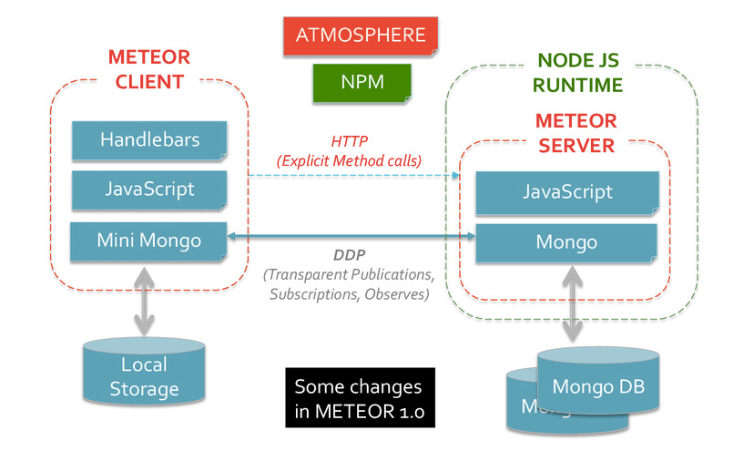
BLOCK DIAGRAM:
Figure 1(a)- Architecture “Meteor”

Slide 9
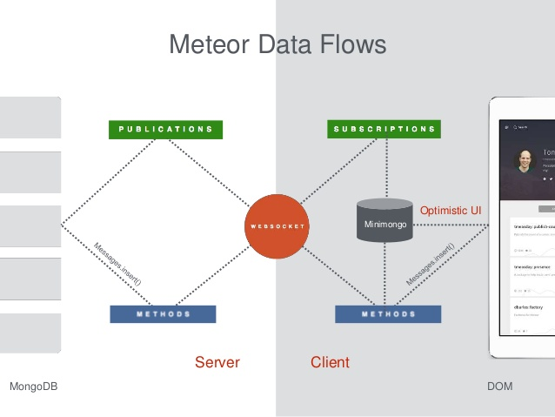
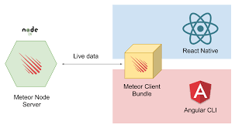
ARCHITECTURE
Figure 1(c)- Architecture “Server Client”
Figure 1(b)- Architecture “Meteor Data Flow”

Slide 10
BACKGROUND:
When we are tracking a device by acquiring geolocation data, it is important to keep an application running in the background so that data can continue to be acquired.
Refreshing of the current geo-location at a specific refresh rate is performed. To fetch the geo-location we use Geolocation's API.

Slide 11

TOOLS & TECHNOLOGIES:
.
Figure 2- CORDOVA

Slide 12

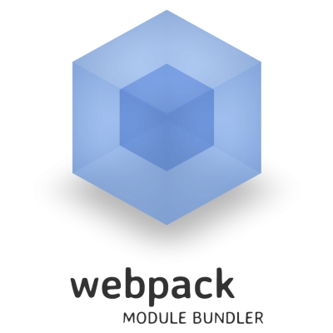
TOOLS & TECHNOLOGIES:
.
Figure 3- Angular and Webpack

Slide 13


TOOLS & TECHNOLOGIES:
Figure 4- Meteor and Ionic

Slide 14
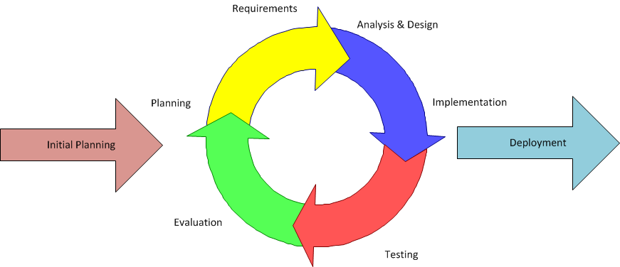
Development methodology:
Figure 5- Iterative Development Model

Slide 15
PROJECT APPLICATIONS:
to implement Facebook authentification and allow users to start new chats with their Facebook friends who already use application.
to implement push notifications using Google's Firebase Cloud Messaging (FCM): whenever a user will send a message, if one doesn't have the application in the foreground he will get a push notification.
to get the devices location (aka geo-location).

Slide 16
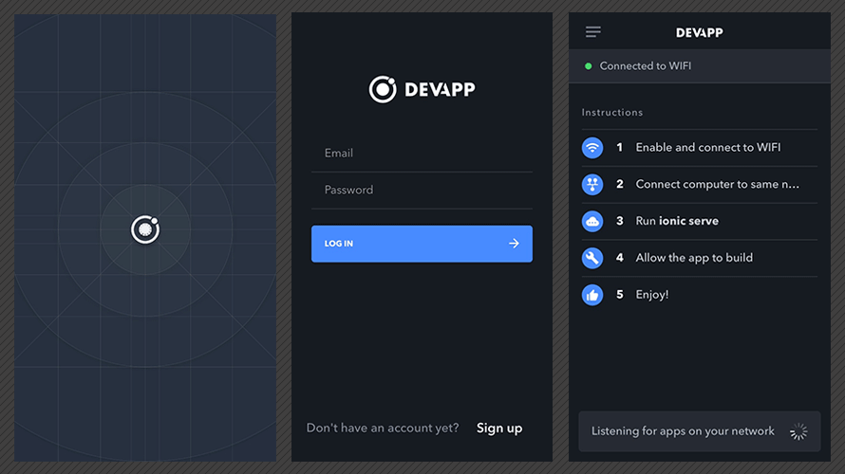
APPLICATION:
.
Figure 6- Screenshot1 ”WHATSAPP CLONE”
.

Slide 17
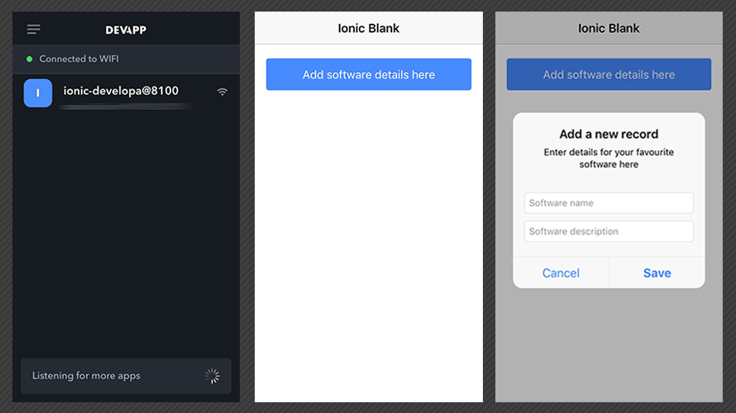
APPLICATION:
Figure 7- Screenshot2 “WHATSAPP CLONE”

Slide 18
CONCLUSION
The goal was to learn angular and build the application for user interaction. We are using Ionic because it's just an addition on top of Angular and it doesn't require to learn a lot of different concepts then just Angular. Also, the steps that require in order to use the Ionic CLI with Meteor are almost identical to the steps that require in order to use the Angular CLI.
We have created a full WhatsApp clone, using Angular and the Ionic Framework, using Meteor’s realtime collections for the chat and Meteor’s simple Authentication packages for SMS based authentication
.

Slide 19
FUTURE SCOPE
Build a chat application very quickly without having to deal with Socket.IO or websockets.
REUSABLE COMPONENTS ALLOW HYBRID APPS TO RENDER NATIVELY
Even the average mobile phones can access internet, forget smart phones

Slide 20
References:
https://angular-meteor.com/tutorials/whatsapp2/ionic/setup
https://www.meteor.com/
https://www.youtube.com/watch?v=Y3Kikk5rPQk
https://angular-meteor.com/angular2

Slide 21
THANK YOU

